Slide 1

Code Refactoring and Bug Fixing
Name: Shaan Mathew

Slide 2
Objective:
Refactor the codebase and ensure the proper functioning of the Note Taking Application.
Document all identified bugs during the debugging process.
Goal is to fix the codebase and make the application work as intended.

Slide 3
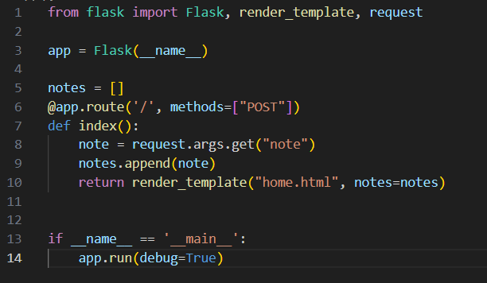
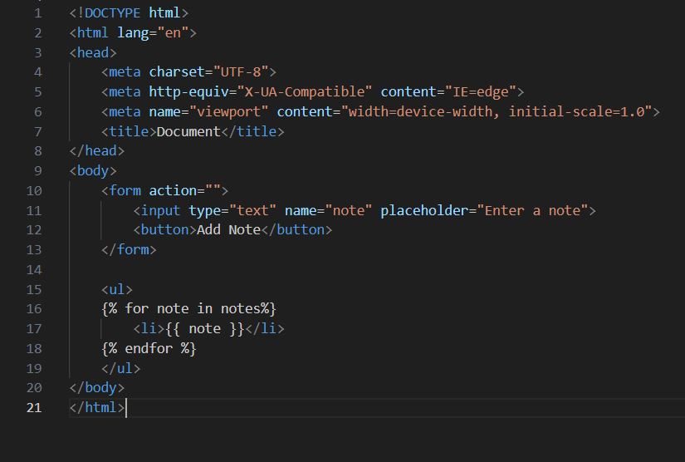
Initial Code
Application Code
HTML Code

Slide 4
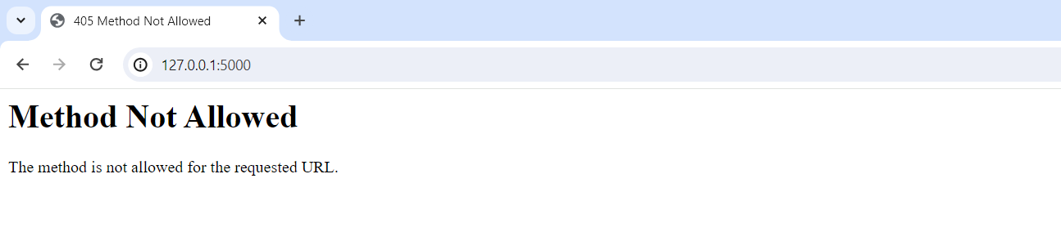
Output of Initial code

Slide 5
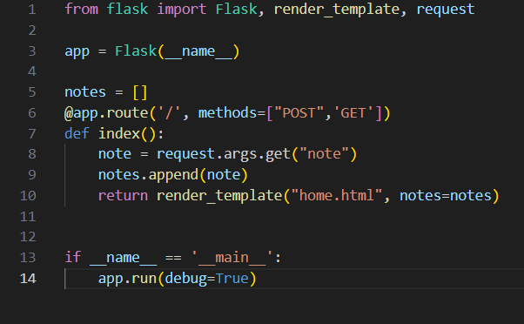
Bug 1
Method Not Allowed
Method used by application code is POST , whereas HTML code is GET method

Slide 6
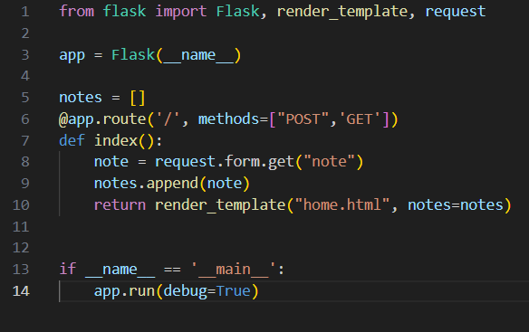
Bug 2
“request.args.get()" method is typically used to retrieve query argument from a URL,
but our HTML template contains a form. Therefore we will use “request.form.get()”

Slide 7
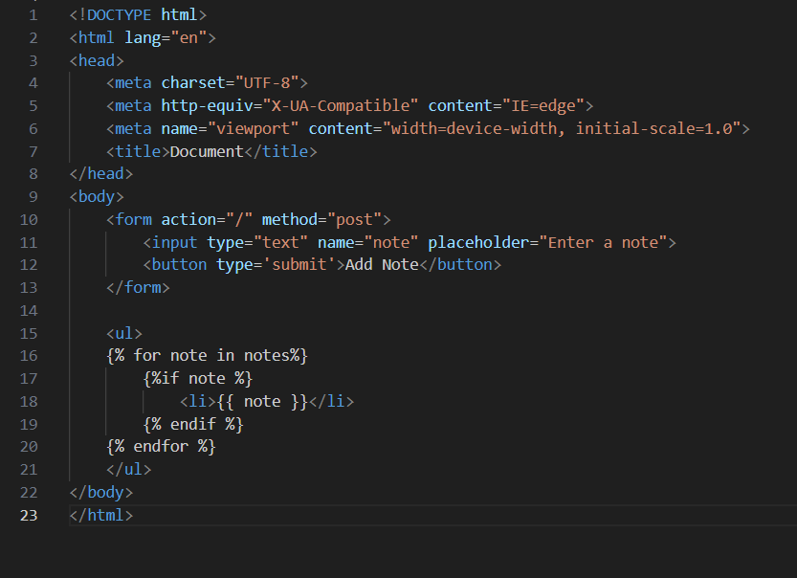
HTML Code Bugs
1
Action and Method attributes are missing
Button type ‘submit’ is missing
In the code snippet, there is a bug where the iteration over the 'notes' list does not check for empty or None values
2
3
1
1
2
2
3
3

Slide 8
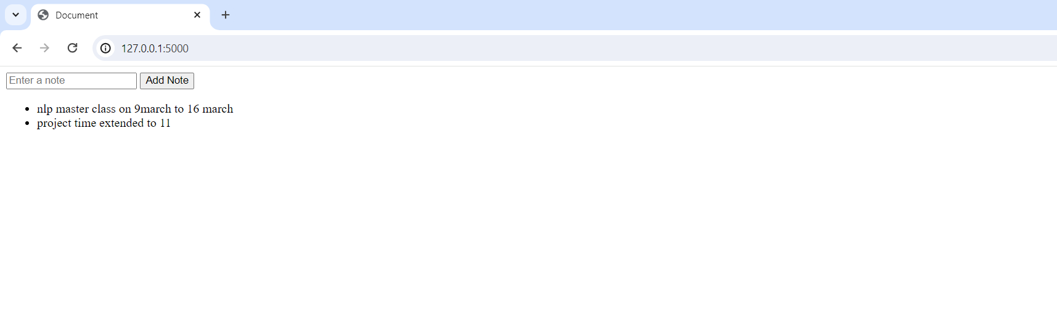
Output – Note Taking App

Slide 9

THANK YOU

